Slide 1
Stock marketing prediction using machine learning

Slide 2
THIRUMALAI ENGINEERING COLLEGE DEPARTMENT OF INFORMATION TECHNOLOGY Project team members SATHYASEELAN S (513220205309) ANANTH A (513220205301) SURENDHAR K (513220205310) ANISHKUMAR T (513220205302) COORDINATER MRS.A.PRIYANKA M.E.,

Slide 3
Introduction
Financial market is one of the greatest inventions of all times that plays an imperative role.
In the whole economy system. Stock market prediction is the process of forecasting.
Determining the prospective values of a company stock. The stock market is a key pivot in a prosperous and growing economy of all the countries.
The system has a graphical user interface and functions as a stand alone applications.
The proposed model is a promising predictive techniques for highly non –linearly time series, whose patterns are difficult to capture y traditional models.

Slide 4
Abstract
Time series forecasting has been widely used to determine the future prices of stock, and the analysis and modelling of finance time series importantly guide investors' decisions and trades
This work proposes an intelligent time series prediction system that uses sliding-window optimization for the purpose of predicting the stock prices
The system has a graphical user interface and functions as a stand-alone application.
The proposed model is a promising predictive technique for highly non-linear time series, whose patterns are difficult to capture by traditional models.

Slide 5
EXISTING SYSTEN
Time series forecasting consists of a research area designed to solve various problems, mainly in the financial area
Support vector regression (SVR), a variant of the SVM, is typically used to solve nonlinear regression problems by constructing the input-output mapping function.
The least squares support vector regression (LSSVR) algorithm is a further development of SVR and its use considerably reduces computational complexity and increases efficiency compared to standard SVR.
The Firefly Algorithm (FA), which is a nature-inspired metaheuristic method, has recently performed extremely well in solving various optimization problems.
DISADVANTAGE
Machine learning algorithm work only for huge sets of data.
For smaller amount of data the results may be not accurate.
It takes significate amount of data for machine.

Slide 6
PROPOSED SYSTEM
To generalize the application of the existing system, our work uses the system to estimate other stocks in similar emerging markets and mature markets
The system can be extended to analyze multivariate time series data and import raw dataset directly
Profit can be maximized even when the corporate stock market is has lower value
The development of a web-based application has been considered to improve the user-friendliness and usability of the expert system.
ADVANTAGE:
1. Removes the Investment Bias
2. Minimizes Your Losses
3. Allows the Smart Way of Making Money

Slide 7
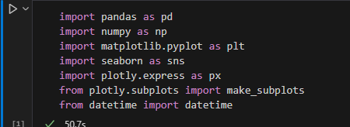
PYTHON PACKAGES
There are several Python packages commonly used for COVID-19 data analysis.
Like NumPy, pandas, seaborn, matplotlib, plotly etc.,

Slide 8
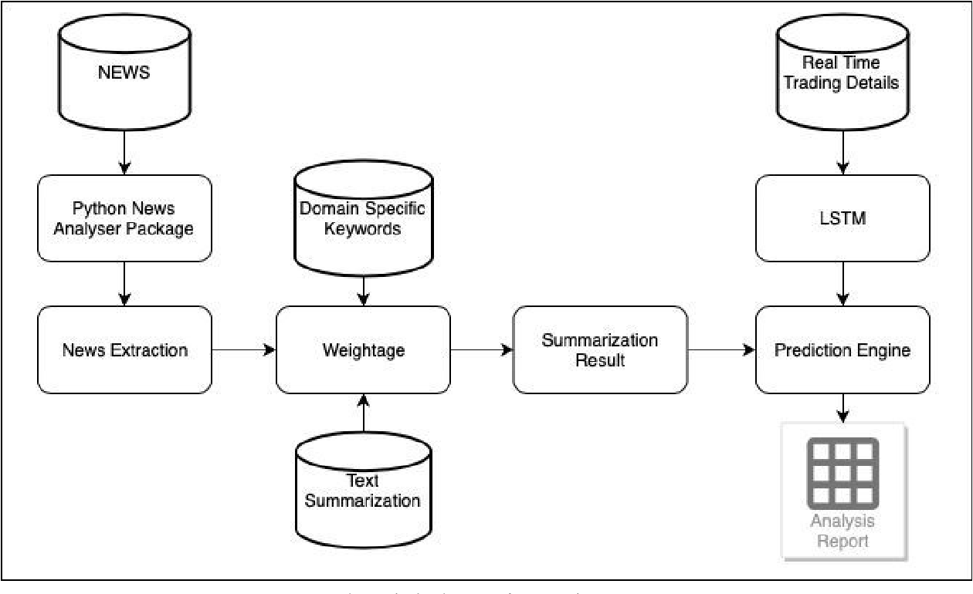
ARCHITECTURE DIAGRAM

Slide 9
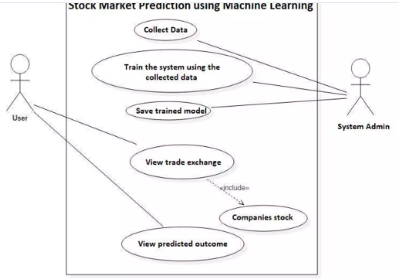
USE CASE DIAGRAM

Slide 10
ALGORITHM LOGISTIC REGRESSION
It is a statistical model that in its basic form uses a logistic function to model a binary dependent variable, although many more complex extension exist.
In regression analysis, logistic regression(1) (or logit regression) is estimation the parameters of a logistic model (a form of binary regression ).
Mathematically ,a binary logistic model has a dependent variable with two possible values ,such as pass fail which is represented by an indicator variable, where the two values are logistic regression.
Supervised Learning Technique.
Correlation Outperformance PCA (Principal Component Analysis) at low features.
Has a 94.6% accuracy for high features count. Doesn’t exhibit overfitting

Slide 11
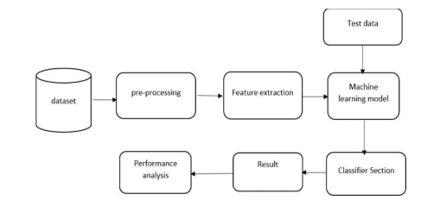
SYSTEM ARCHITECTURE DIAGRAM

Slide 12
PACKAGES
Which are being used for data exploration, pro processing and for using random forest algorithm are:
NumPy: For simple arrays.
Pandas: For reading the file.
SciKit: Learn- for pre-processing.
Matplotlib or Seaborn: For plotting and representing confusion matrix color format.
Tensor flow: For matrix format.

Slide 13
System requirements
Hardware Requirements:
RAM:4GB and Higher
Processor:Intel i3 and above
Hard Disk:500GB: Minimum
Software Requirements:
OS:Windows or Linux
Python IDE:python 2.7.x and above
Jupyter Notebook
Setup tools and pip to be installed for 3.6 and above
Language :python

Slide 14
MODULES
Module 1 : Frame the problem.
Module 2 : Collect raw data.
Module 3 : Import the libraries (pandas,numpy,sklearn
etc.,).
Module 4 : process the data for analysis.(explore the
data).
Module 5 : perform in-depth analysis.
Module 6 : communicate results of the analysis.

Slide 15
Splitting, imputation , interpolation
Splitting – pandas sample() is used to generate sample random row or column from the data frame.
Imputation – The process of replacing the missing data with substituted values.
Interpolation – A method of constructing new data points within the range of a discrete set of know points.

Slide 16
IMPLEMENTATION
Data Collection: Gather historical transaction data, including both legitimate and fraudulent transactions.
Data Preprocessing: Clean the data, handle missing values, normalize or scale numerical features, and encode categorical features.
Model Selection: Choose appropriate machine learning algorithms for fraud detection, such as logistic regression, decision trees, random forests, support vector machines, or neural networks.
Deployment: Deploy the trained model into a production environment where it can analyze real-time transactions.
Monitoring and Updating: Continuously monitor the performance of the deployed model and update it periodically to adapt to new fraud patterns or changes in the data distribution.
Integration with Fraud Prevention Systems: Integrate the fraud detection system with other fraud prevention measures such as rule-based systems, anomaly detection, and manual review processes for suspicious transactions.

Slide 17
FUTURE ENHANCEMENT
There are several avenues for enhancing stock market prediction using machine learning
Feature Engineering: Continuously explore and refine the features used in the models Ensemble Methods: Utilize ensemble learning techniques such as bagging, boosting, or stacking to combine multiple models for improved prediction accuracy and robustness.
Deep Learning Architectures: Explore more advanced deep learning architectures such as recurrent neural networks (RNNs), long short-term memory networks (LSTMs), or transformers, which are well-suited for modeling sequential and temporal data like stock prices Attention Mechanisms:
Implement attention mechanisms within deep learning architectures to focus on relevant parts of the input data, potentially improving model interpretability and performance.
Reinforcement Learning: Investigate the use of reinforcement learning techniques to develop trading strategies that dynamically adapt to changing market conditions and optimize trading decisions over time.

Slide 18
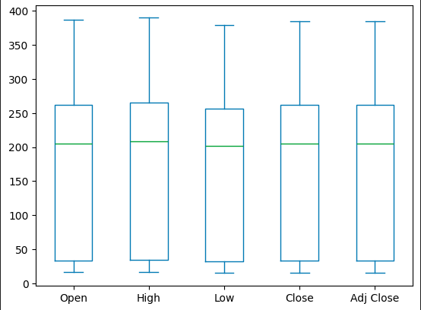
SAMPLE OUTPUT

Slide 19
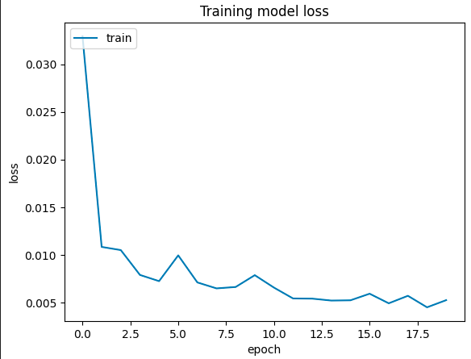
TRAINING MODEL

Slide 20
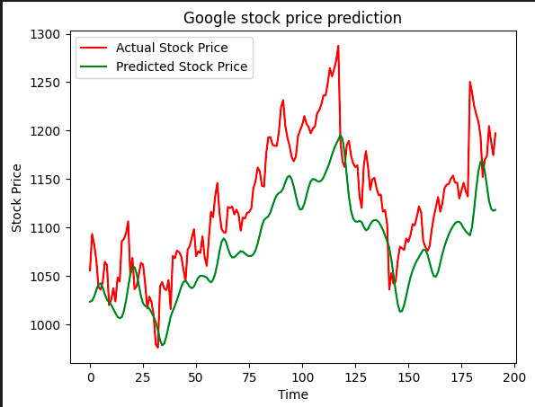
STOCK PRICE PRREDICTION

Slide 21
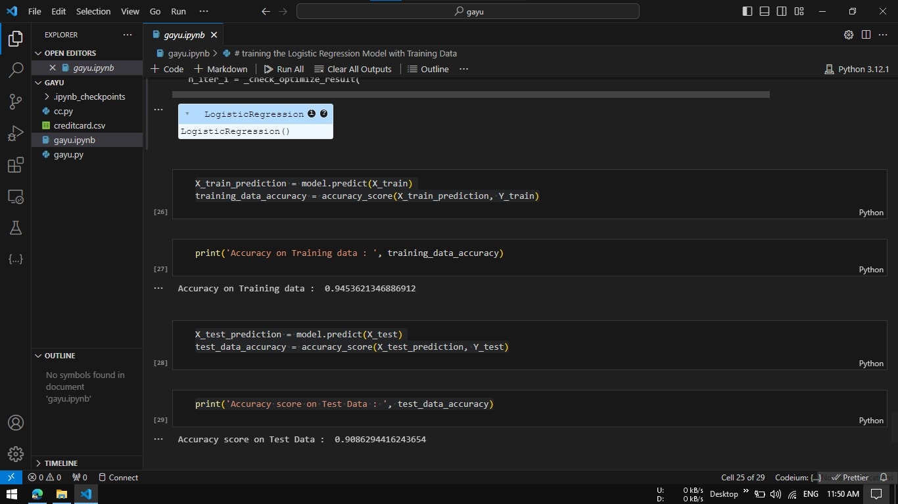
ACCURACY

Slide 22
CONCLUSION
Financial markets provides an essential platform for ﬁnancial transactions.
Investments to happen and the it allows people to have the opportunity of making their investment growth.
Therefore, stock market prediction is essential in helping the investors make correct and proﬁtable decisions.
Examining the role of external factors in stock market prediction can be an important aspect in the future study and machine learning deﬁnitely plays and important role.

Slide 23
REFERENCES
1. Machine Learning Techniques Applied to Stock Price Prediction" by Haidar Khan, Ashish Sureka, and Arun Kumar Yadav. Published in the International Journal of Computer Applications, this paper provides an overview of various machine learning techniques applied to stock price prediction, including neural networks, support vector machines, and genetic algorithms.
2. "Stock Price Prediction Using Machine Learning Algorithms" by Sanket Patel, Abhishek Kumar, and Mohit Sharma. This paper, available on arXiv, explores the application of machine learning algorithms such as random forests, gradient boosting, and long short-term memory networks (LSTMs) for predicting stock prices.
3. Stock Market Prediction Using Machine Learning and Sentiment Analysis" by Xiao Ding, Yue Zhang, Ting Liu, and Junwen Duan. Published in the Proceedings of the 52nd Annual Meeting of the Association for Computational Linguistics, this paper investigates the combination of machine learning techniques with sentiment analysis of news articles for stock market prediction.
4."Stock Market Prediction Using Machine Learning Algorithms with Fundamental and Technical Analysis" by Manisha Kumbhar, Snehal Shikalgar, and Pramod Patil. Presented at the 2018 International Conference on Computing, Communication, Control, and Automation, this paper explores the integration of fundamental and technical analysis with machine learning algorithms for stock market prediction

Slide 24


